Slide 1



Data Science: The Main Course
I Can Science Data, and So Can You!
Arthur Doler
@arthurdoler
arthurdoler@gmail.com

Slide 2





































TITANIUM SPONSORS
Platinum Sponsors
Gold Sponsors

Slide 3
How many appetizers have you eaten?

Slide 4
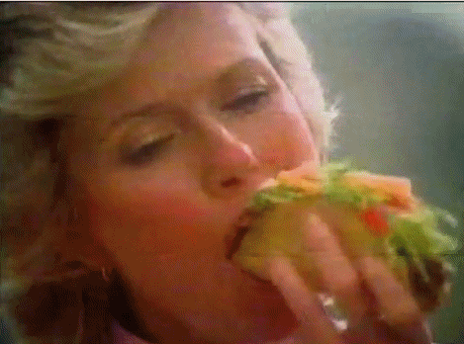
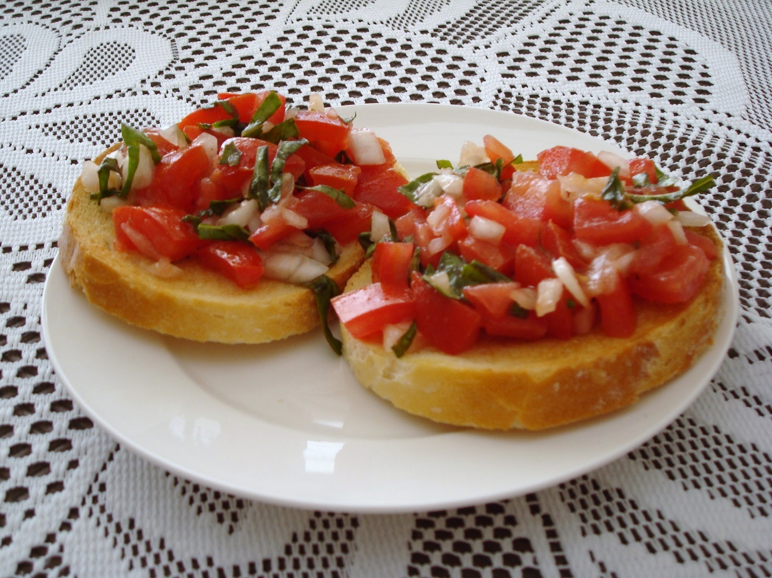
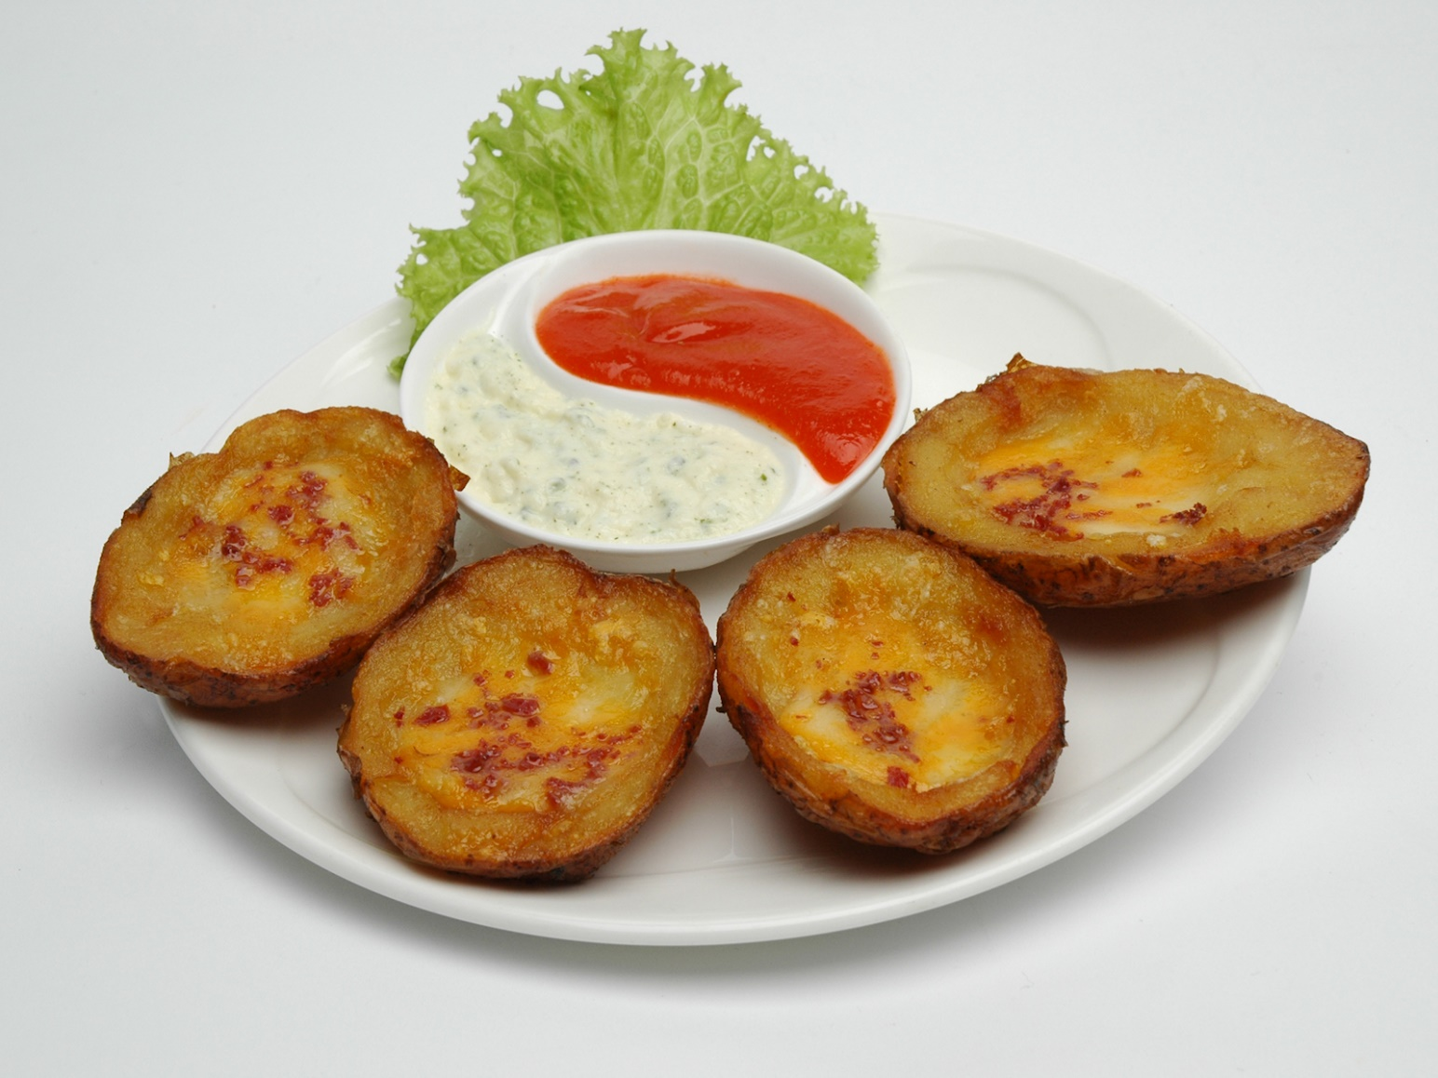
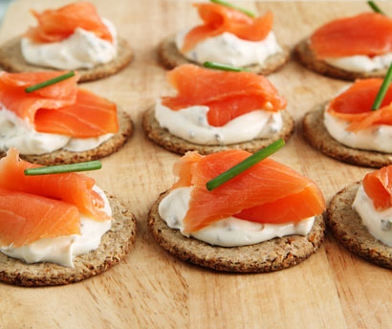
Sources: Mediawiki, Publicdomainpictures.net

Slide 5
So we’re skipping right to the main course
You have the data You have the power

Slide 6

Sources: Mattel, he-manreviewed.net

Slide 7
What’s for dinner

Slide 8
Picking your problem
Using Knitr/R Markdown
Building a linear predictor
Making a predictive, repeatable document

Slide 9
What’s not for dinner

Slide 10
Learning R
Exhaustive discussion of statistics
Exhaustive discussion of regression modeling
Ways to run R in production

Slide 11
Step 0: know your recipe for repeatability
Learn to Knit you some R

Slide 12
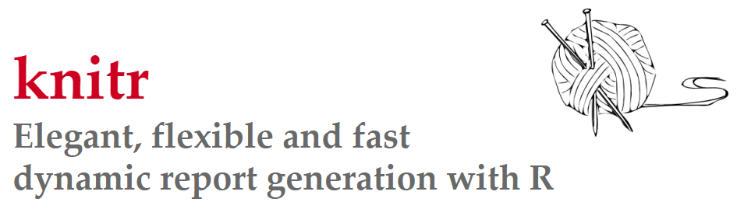
knitr ≈ Sweave + cacheSweave + pgfSweave + weaver + animation::saveLatex + R2HTML::RweaveHTML + highlight::HighlightWeaveLatex + 0.2 * brew + 0.1 * SweaveListingUtils + more

Slide 13

Source: Reddit

Slide 14
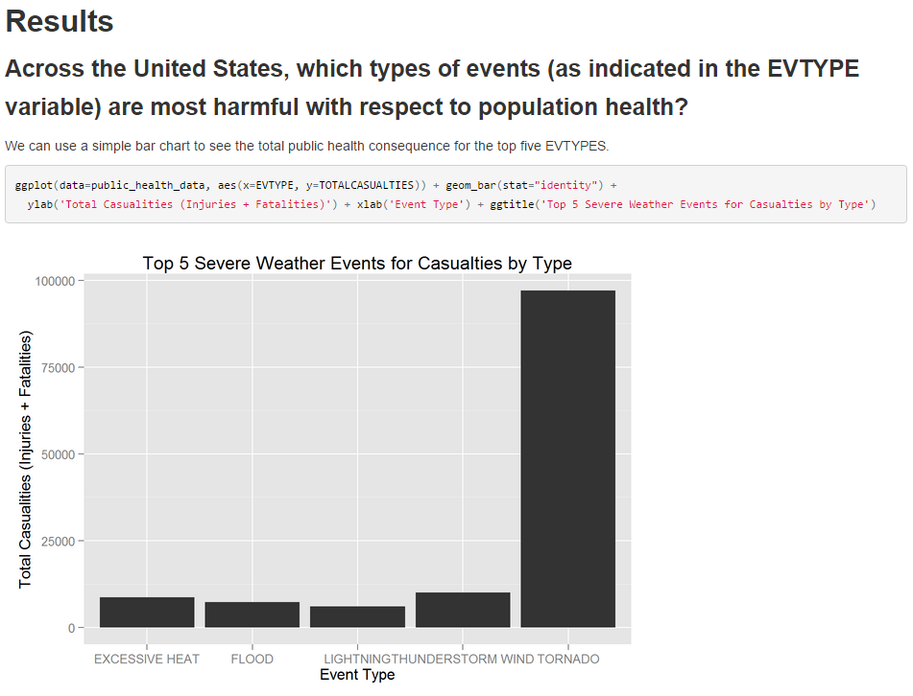
Markup
R Code
Markup
R Code
Markup

Slide 15
What?! Why is this a good idea?

Slide 16
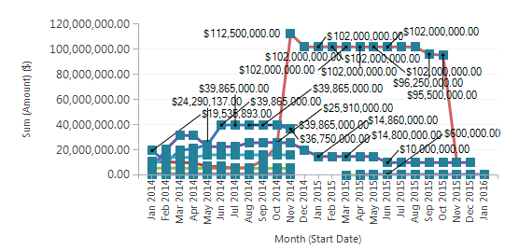

Do you love me?
Y
N

Slide 17
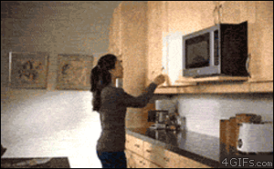
Let’s go find that recipe!
Source: Reddit

Slide 18
Step 1: Shop for your ingredients
Finding the question to ask

Slide 19
What are you trying to do?

Slide 20
Finding or proving a correlation
Looking for outliers
Building a predictive model

Slide 21
Let’s build a linear predictive model

Slide 22


Slide 23
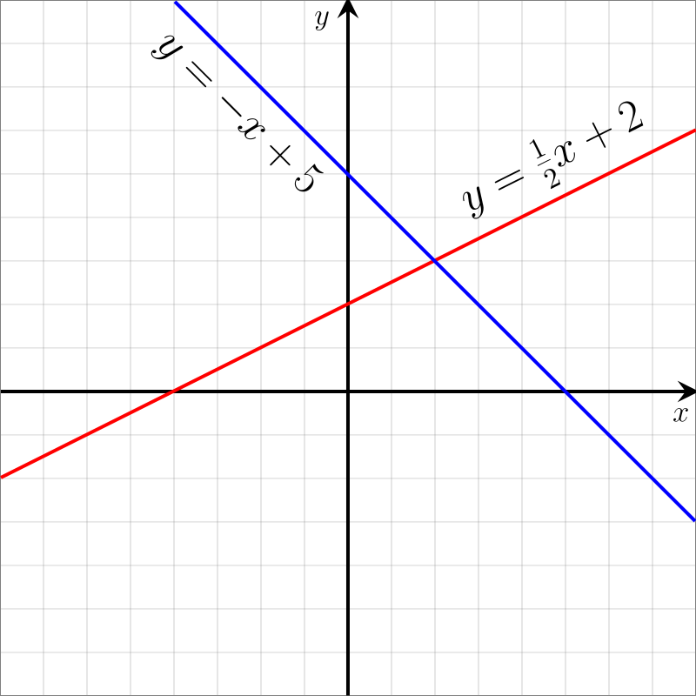
Source: Wikipedia

Slide 24
What are your variables?

Slide 25
Material Category
Material ID
Time-to-Incapacitation
1000 / Time-To-Incapacitation
Carbon Monoxide
Hydrogen Cyanide
Hydrogen Sulfide
Hydrochloric Acid
Hydrobromic Acid
Nitrogen Dioxide
Sulfur Dioxide

Slide 26
What do you care about?

Slide 27
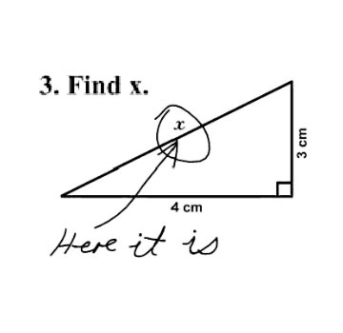

Slide 28
Formulate your question

Slide 29
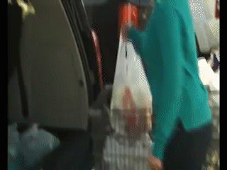
Let’s head to the store!
Source: Reddit

Slide 30
Step 2: Get your mise en place
Dividing your data

Slide 31
Where is the value in a predictive model?

Slide 32
We build our model with a training set

Slide 33
Partitioning your data prevents overtraining

Slide 34
²⁄_{³} Training
¹⁄_{³} Test
½ Training
¼ Test
¼ Validation

Slide 35
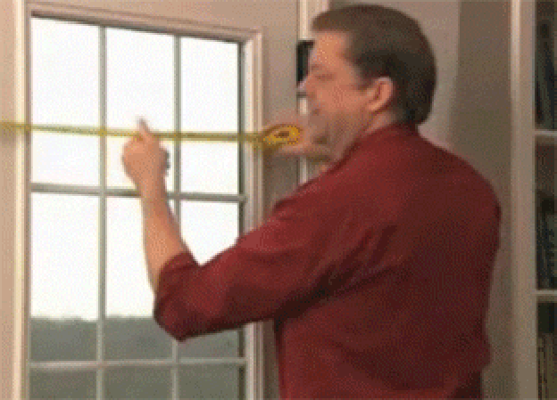
Let’s measure everything out!
Source: Reddit

Slide 36
Step 3: Cook up your predictor
Training your model

Slide 37
One warning first
Do you need to understand your predictor?

Slide 38
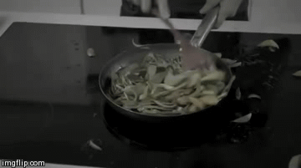
Let’s go cook up the model!
Source: Reddit

Slide 39
Why did 1000/Time_to_Incapacitation work better?

Slide 40
Step 3a: Trim the Fat
Eliminating Outliers

Slide 41
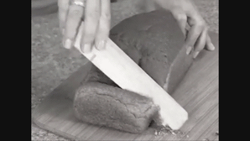
Let’s go cut!
Source: Reddit

Slide 42
Step 4: Garnish with graphics
Adding visualizations to your report

Slide 43
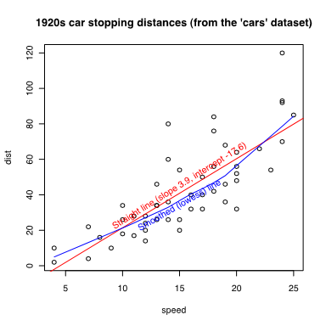
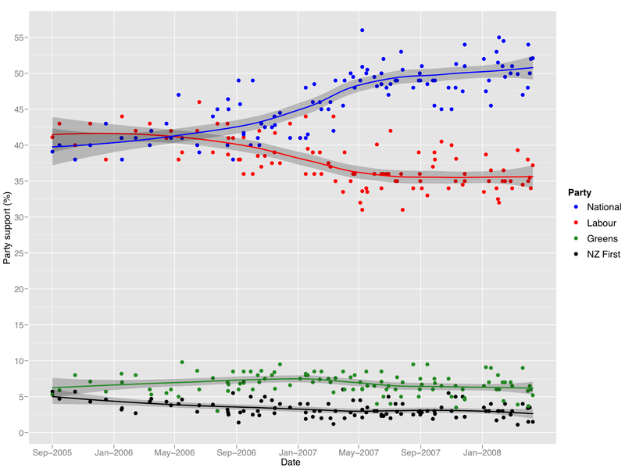
plot ggplot2
Source: Wikimedia

Slide 44
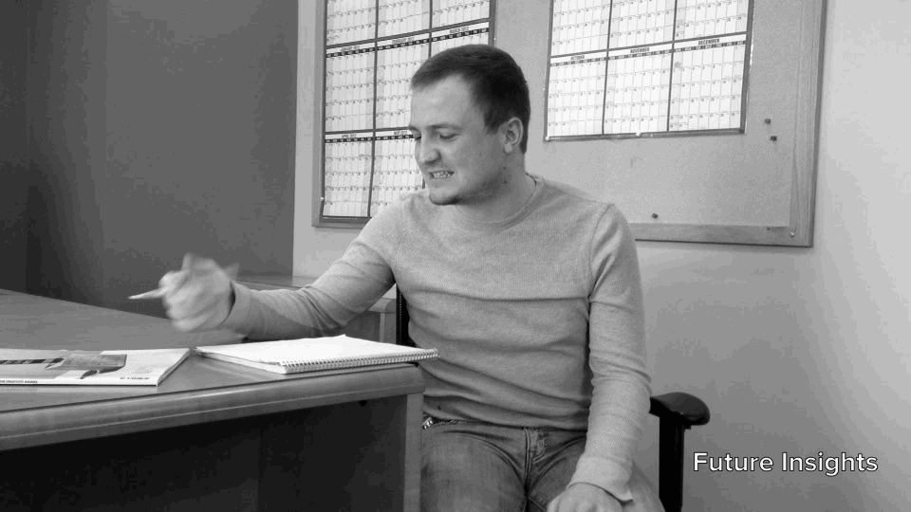
Let’s finish up that report!
Source: Reddit

Slide 45
The Final Menu
Know Your Recipe for Repeatability
Shop for Your Column Ingredients
Get your Data Divided
Cook Up Your Predictor
Trim the Outlier Fat
Garnish with Graphics

Slide 46
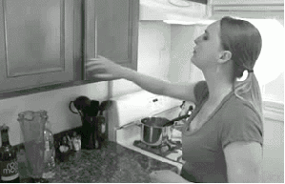
Questions?
Source: Reddit
@arthurdoler
arthurdoler@gmail.com

